Slide 1
UML (Unified Modeling Language)

Slide 2
Activity diagram
Activity diagrams describe how activities are coordinated.
  For example, an activity diagram may be used (like an interaction diagram) to show how an operation could be implemented
An activity diagram is particularly useful
  when you know that an operation has to achieve a number of different things, and

Slide 3
Activity diagram
  you want to model what the essential dependencies between them are, before you decide in what order to do them
Activity diagrams are much better at showing this clearly than interaction diagrams.
  Activity diagrams model the workflow of a business process and the sequence of activities in a process.

Slide 4
Activity diagrams
  These diagrams are very similar to a flowchart because you can model a workflow from activity to activity or from activity to state.
  It is often beneficial to create an activity diagram early in the modeling of a process to help you understand the overall process.
  Activity diagrams are also useful when you want to describe parallel behavior or illustrate how behaviors in several use cases interact.

Slide 5
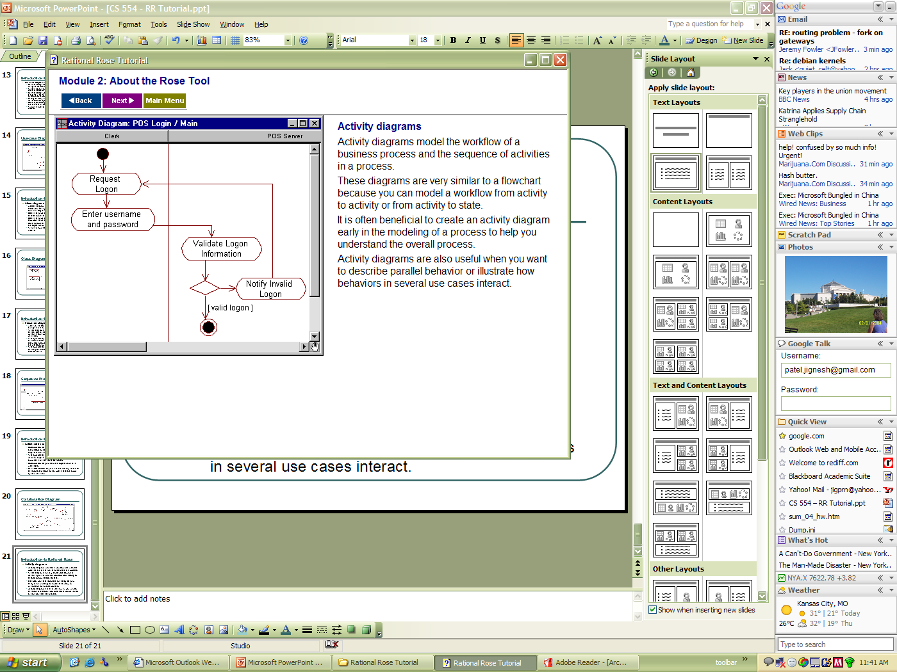
Activity Diagram

Slide 6
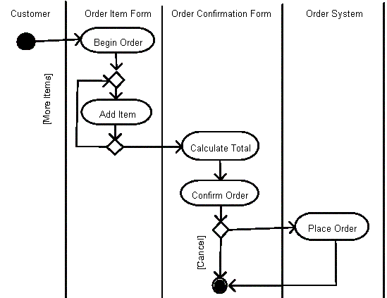

Slide 7
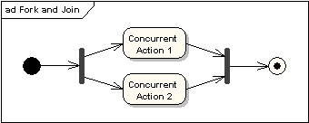
Fork and Join Nodes
Forks and joins have the same notation: either a horizontal or vertical bar (the orientation is dependent on whether the control flow is running left to right or top to bottom).
They indicate the start and end of concurrent threads of control.
The following diagram shows an example of their use.

Slide 8
Fork and Join Nodes (cont)
A join is different from a merge in that the join synchronizes two inflows and produces a single outflow.
The outflow from a join cannot execute until all inflows have been received.
A merge passes any control flows straight through it.
If two or more inflows are received by a merge symbol, the action pointed to by its outflow is executed two or more times.

Slide 9
At the UML semantics level, activity diagrams are state diagrams extended for convenience with some extra notation
Elements of activity diagrams
  Activity
  Transition
  Synchronization bar
  Decision diamond
  Start and stop markers

Slide 10
Swim Lanes
There is one other big notational element to activity diagrams, Swim Lanes.
Swim Lanes are used to illustrate which portions of a system are responsible for particular elements of your diagram.
Here's an example:
This diagram illustrates a User and a Website. The user is attempting to log on to the website. As you can see, the User is responsible for providing login credentials, while the Website is responsible for authenticating the user.

Slide 11
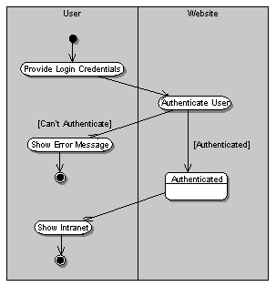
Example of activity diagram with swim lanes:

Slide 12
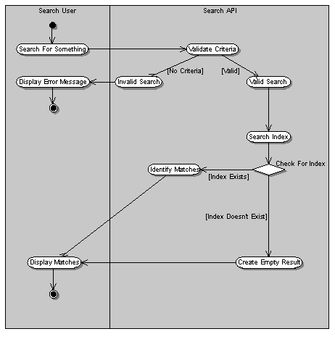
Example of swim lanes activity diagram:

Slide 13
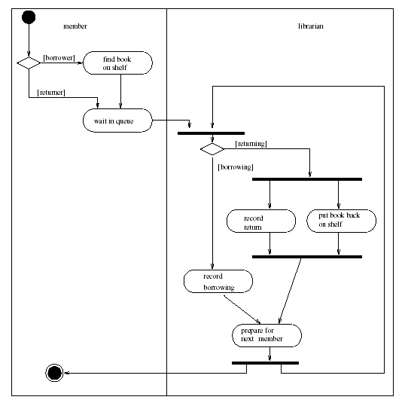
Business level activity diagram of the library

Slide 14
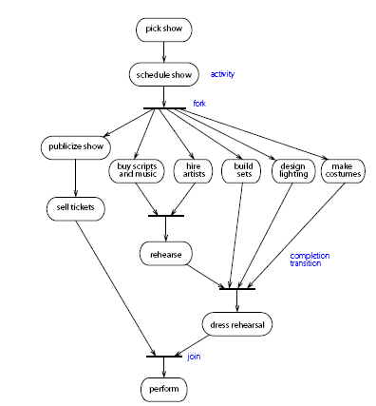
Example:

Slide 15
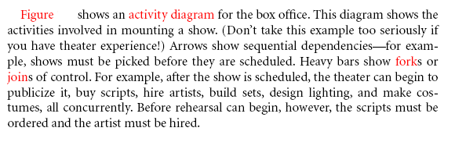
Example:

Slide 16
State chart diagrams
  You can use state chart diagrams to model the dynamic behavior of individual classes or objects.
  State chart diagrams show the sequences of states that an object goes through, the events that cause a transition from one state or activity to another, and the actions that result from a state or activity change.

Slide 17
State chart diagrams
  A state chart diagram is typically used to model the discrete stages of an object’s lifetime, whereas an activity diagram is better suited to model the sequence of activities in a process.
  It shows how behavior of an object changes across several use case execution.

Slide 18
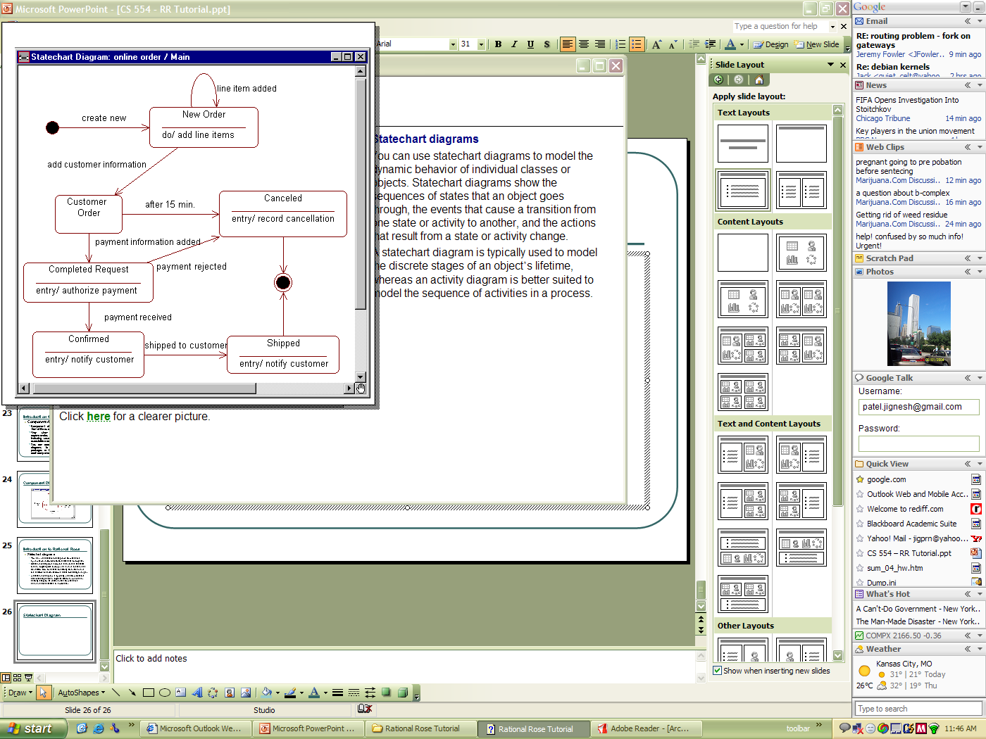
State Chart

Slide 19
State Diagrams
Let us start with a very simple example
    in which an object receives a message and what it does depends on the values of its attributes and links.
In our library system an object of class Copy may have a Boolean attribute onShelf
    which is intended to record whether the object describes a copy of a book
      which is currently in the library,
      or one which is currently on loan.
The interface of a class Copy specifies that the object should be willing to accept the message borrow().

Slide 20
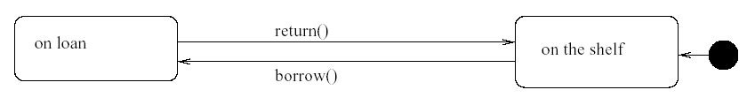
State diagram of class Copy
The value of the copy’s attribute onShelf is important for understanding the behaviour of the object,
  at level of what messages it sends after receiving message itself
We can name two significantly different states of a Copy object
  “on the shelf” and “on loan”
We can record the messages that cause it to move between the states as the events that cause transition between states.

Slide 21
Unexpected messages
In previous figure we have not shown arrows to represent
  the receipt of message borrow() in state “on loan” or
  the message return() in state “on shelf”
Under normal circumstances, such messages should not arrive: if they do it’s a bug.
So the code of class Copy will have to do something if these “wrong” messages do arrive
In fact our convention is a departure from UML, which specifies that an event, such as the arrival of message, that does not trigger a transition is simply ignored

Slide 22
State, transitions, events
The most important elements of a state diagram, namely:
States
  Shown as boxes with rounded corners
Transitions between states
  Shown as arrows
Events that cause transitions between states
  Shown by writing the message on the transition arrow
Start marker
  Shown as a black blob with an (unlabeled) arrow into the initial state of the diagram
Stop marker
  Shown by a black blob with a ring round it
    and means that the object has reached the end of its life.

Slide 23
Actions
The state diagrams were useful for understanding how an object’s reaction to a message depends on its state.
An object sending a message in response to being sent one itself
  is an example of an action being an object’s reaction to an event.
An event is something done to the object
    such as it being sent a message
An action is something that the object does
    such as it sending a message

Slide 24
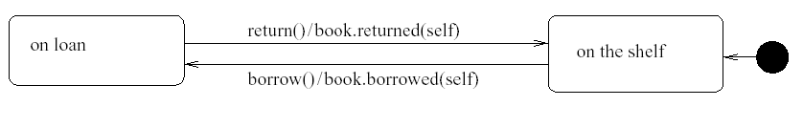
State diagram of class Copy with action
Analysing the notation:
  The slash (/) shows that what follows is an action
  book followed by a dot identifies the object to which a message is being sent
  returned(self) is an example of a message including a parameter, where self is reference to itself

Slide 25
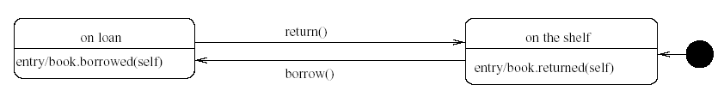
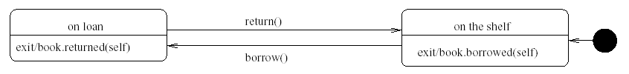
State diagram of class Copy with
- entry action
- exit action
We can show our intention directly, by writing the action inside the state, as a reaction to the special event (e.g entry or exit)

Slide 26
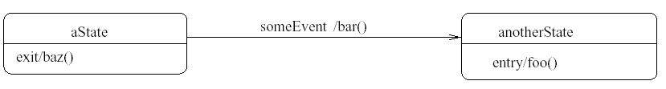
Guards
Sometimes the occurrence of the same event in the same state may or may not cause a change of state,
  depending on the exact values of the object’s attributes
We can show this using the same conditional notation that is used in generic interaction diagrams
Several actions in one diagram.

Slide 27
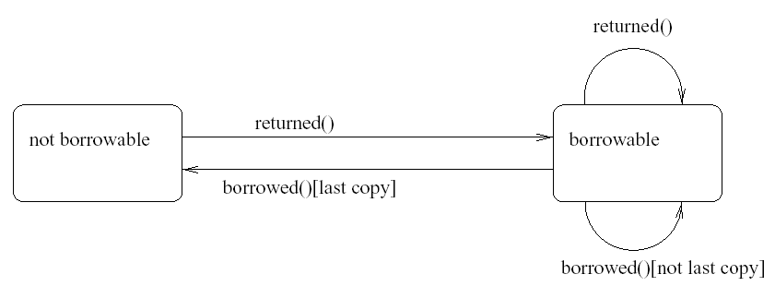
State diagram for class Book
The borrowed() message cause a state change out of state borrowable
  only if this is the last copy on the shelf;
  otherwise, the book object remains borrowable.

Slide 28
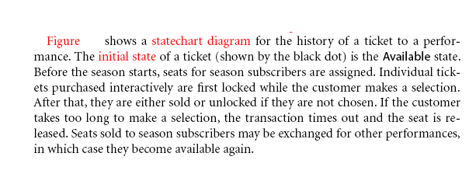
Example of state chart diagram:

Slide 29
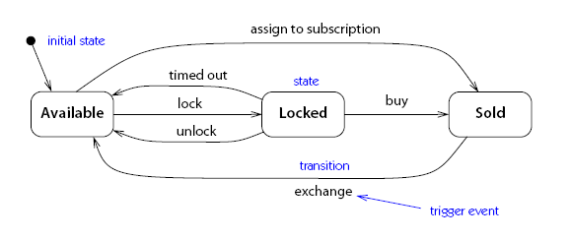
Example of state chart diagram:

Slide 30
The main differences between activity diagrams and state diagrams:
Activity diagrams do not normally include events
Activity is intended to proceed, following the flow described by diagram, without getting stuck

